Slide 1


Slide 2
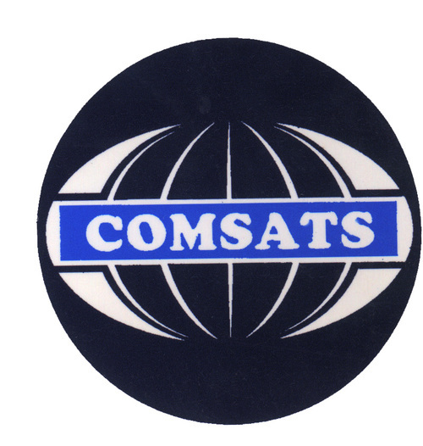
PRESENTATION FOR SIR SIKANDAR KHAN

Slide 3
PRESENTED BY
M.SAEED UL HASSAN RAZA
FA14-BCE-001
ARBAB SAIFULLAH
FA14-BCE-014
MUHAMMAD AFAQ
FA14-BCE-012

Slide 4
TOPIC :
INDUCTANCE OF
A SOLENOID
Applied Physics

Slide 5
LIST OF CONTANTS
Background & History.
Definitions.
Derivation.
Self & Mutual Inductance.
Advantages and Uses
References
(INDUCTANCE OF A SOLENOID)

Slide 6
BACKGROUND
The early studies of electrical conduction in metals were done in the eighteenth and early nineteenth centuries.
Benjamin Franklin (1706-1790) in his experiments with lightning found that the charge would travel along the metallic rod.
Alessandro Volta (1745-1827) derived the concept of electrical battery.
Once batteries were available for contact with metals, electric currents were produced and studied.
Georg Simon Ohm (1787-1854) found the direct proportion relating current and potential difference,
which became a measure of the ability of various metals to conduct
electricity.
And then conductance was defined.

Slide 7
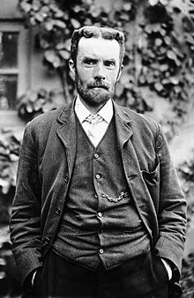
HISTORY
The term 'inductance' was introduced by
Oliver Heaviside in February 1886.
Then in honor and work of the physicist Heinrich Lenz, It is made to use the symbol (L) for inductance.
In the SI system the measurement unit for inductance is the henry (symbol: H), named in honor of the scientist who discovered inductance, Joseph Henry.
Here you see names of different scientist what it means?

Slide 8
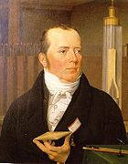
HISTORY
If you look at the background of Inductance.
You will come to know Inductance have very brief history and background.
Different scientists work on it used it in different ways.
Example :
In 1820, Han Christian Oersted,
a Danish physics teacher, found that
electricity and magnetism are related and hence introduce Electromagnetism.

Slide 9
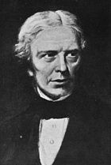
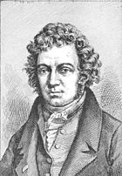
Scientist worked on this Subject
Coulomb
Faraday
Gauss
Oliver Heaviside
Henry
Hertz
Lorentz
Maxwell
Tesla
Volta
Ampère
Oersted etc…………..
Hans Christian Ørsted
Michael Faraday
André-Marie Ampère

Slide 10
Definitions
Inductance of a Solenoid
Solenoid
Inductance

Slide 11
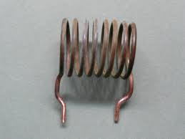
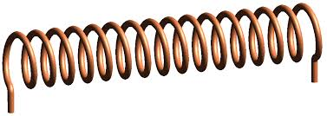
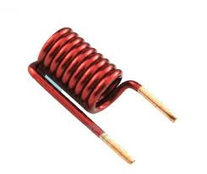
SOLENOID
DEFINITION
In physics, the term refers specifically to a long, thin loop of wire.
Solenoids are commonly used for inductors

Slide 12
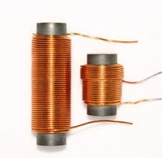
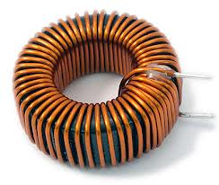
INDUCTOR
DEFINITION
When this long, thin loop of wire wrapped around a metallic core, which produces a uniform magnetic field in a volume of space when an electric current is passed through it is called Inductor.

Slide 13
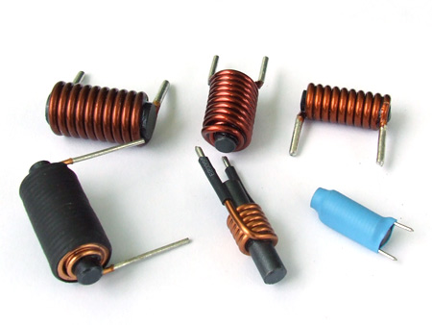
DIFFERENT INDUCTOR

Slide 14
INDUCTANCE
DEFINITION
Inductance is the name given to the property of a component that opposes the change of current flowing through it.
Inductors do this by generating a self-induced emf within itself as a result of their changing magnetic field or changing magnetic flux.

Slide 15
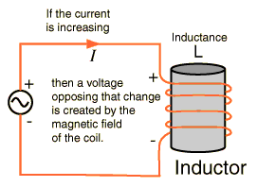
Is called Induced Emf

Slide 16
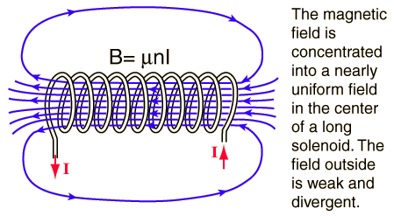
DERIVATION OF INDUCTANCE OF A SOLENOID
Consider a solenoid. Run current through it
and you've got yourself an electromagnet.
The magnetic field or flux density B inside
the turns of a solenoid is given by the formula
B = μ₀nI
n = No. of turns per unit length
I = Current
B = Magnetic field
μ_{ο} is the Permeability of Free Space (4.π.10⁻⁷)

Slide 17
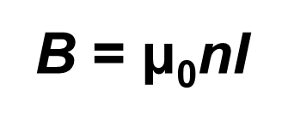
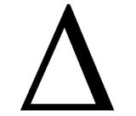
Eq-1
n = N/L
L is length of Solenoid
N is total no. of turns
Modifying Eq-1
N | I
ℓ
Eq-2
B = μ₀
If A is area of cross section of solenoid, then the magnetic flux is given by
Φ_{B} = BA
Putting Φ_{B} =BA in equation 2
Delta shows change in
current which also
cause change in flux
N | I
ℓ
or
Φ_{B} = μ₀ n I A
Φ_{B} = μ₀ A
Φ_{B} = μ₀ n I A

Slide 18
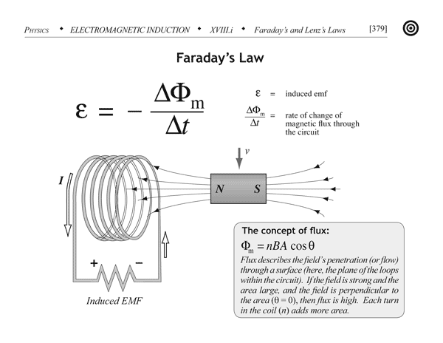
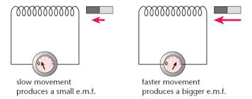

Slide 19
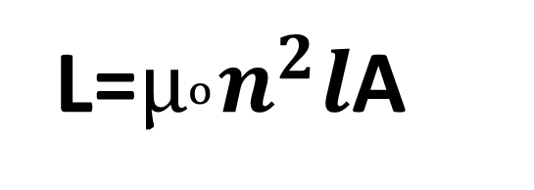
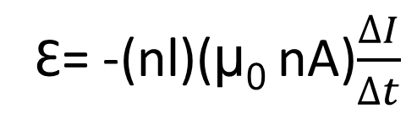
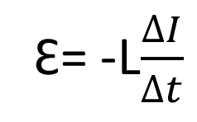
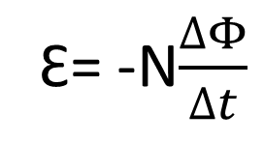
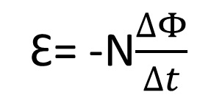
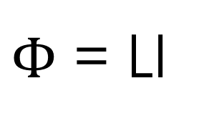
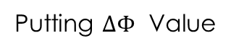
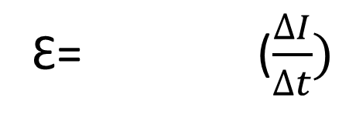
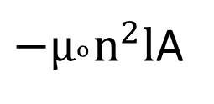
Now according to Faraday’s law, the induced emf is
Whenever magnetic flux linking a circuit is changed ,emf is induced.
The magnitude of induced emf is equal to –ve time rate
Of change of magnetic flux through the circuit.
Ԑ= -N$\frac{∆Φ}{∆t}$
Self inductance
$Φ$ = LI
Putting $∆Φ$ Value
Ԑ= -(nl)(μ₀ nA)$\frac{∆I}{∆t}$
Faraday’s law
Ԑ= -N$\frac{∆Φ}{∆t}$
Ԑ= ($\frac{∆I}{∆t})$
${−µ}_{ᵒ}n^{2}l$A
Ԑ= -L$\frac{∆I}{∆t}$
Now Comparing both emf values written above
We get the result
L=$µ_{ᵒ}n^{2}l$A

Slide 20
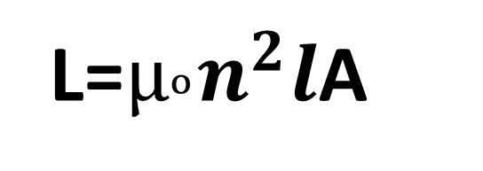
EXPRESSION FOR INDUCTANCE OF A SOLENOID
L=$µ_{ᵒ}n^{2}l$A
Where:
L is in Henries (Inductance)
μο is the Permeability of Free Space (4.π.*10-7)
n is the Number of turns per unit length
A is the Inner Core Area (π.r^2) in m^2
l(small) is the length of the Coil in meters

Slide 21
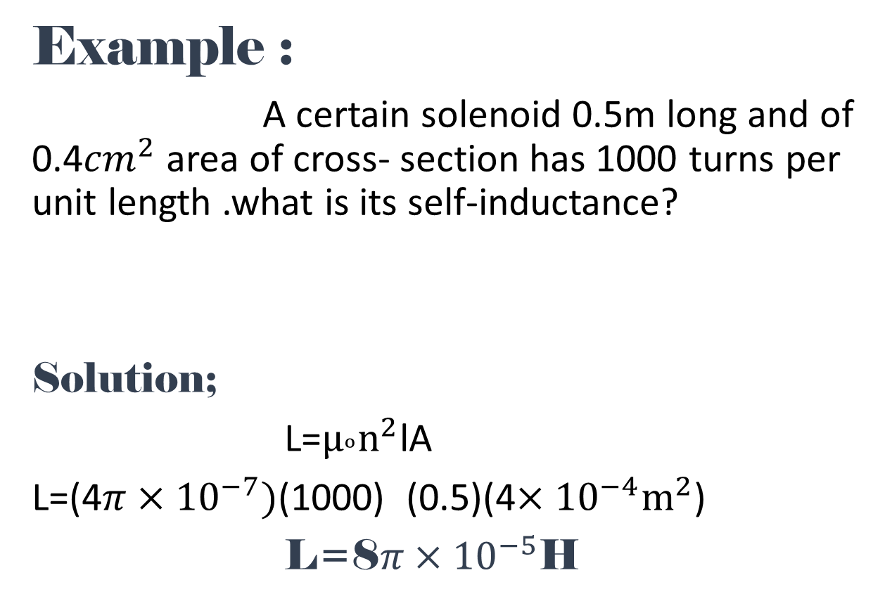
Example :
A certain solenoid 0.5m long and of 0.4${cm}^{2}$ area of cross- section has 1000 turns per unit length .what is its self-inductance?
Solution;
L=$µ_{ᵒ}n^{2}$lA
L=(4$π×{10}^{−7})$(1000) (0.5)(4$×{10}^{−4}m^{2}$)
L=8$π×{10}^{−5}$H

Slide 22
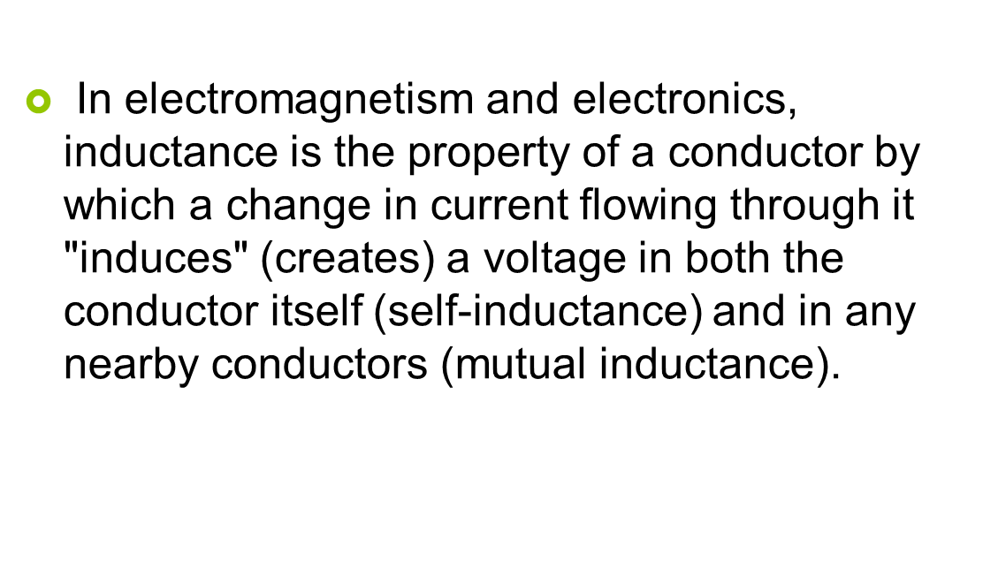
INDUCTANCE
While Self-Inductance and Mutual Inductance are
the two types of Inductance.

Slide 23
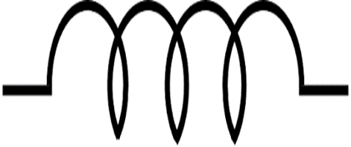
INDUCTANCE
SYMBOL
UNIT
In the SI system the measurement unit for inductance is the Henry (symbol: H), named in honor of the scientist who discovered inductance, Joseph Henry.

Slide 24
TYPES OF INDUCTANCE
Self Inductance
Mutual Inductance

Slide 25
Self induction
INDUCTANCE TYPES
The effect that a changing current in a circuit or coil produce an emf in the same circuit or coil is called self induction.
The fact is when a current flows in a coil, the current causes a flux through the same coil if the current change the flux produce by the current also change so an emf is induced in the coil..

Slide 26
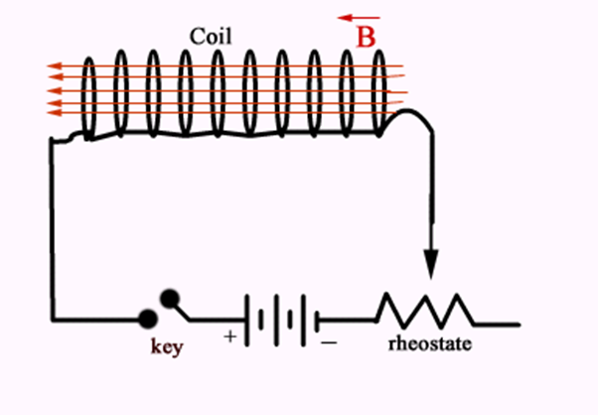
Remember for the production of Induced emf the change in flux is important.
In the figure current is changed through
rheostat which result
in change of flux,
Thus producing emf and
the phenomenon of self inductance occurs.

Slide 27
Mutual Induction
The effect which results In an emf being produced in one coil due to changing current in another
coil is called mutual induction.

Slide 28
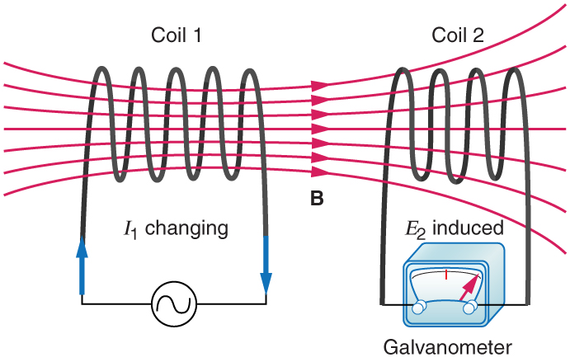
Primary Coil
Secondary Coil

Slide 29
In previous diagram change of flux
take place due AC current
as +ve and –ve terminals of
AC changes,this causes Change in flux
in primary coil and then simultaneously
this result in changing of flux through
secondary coil.
This phenomenon is called
mutual induction.

Slide 30
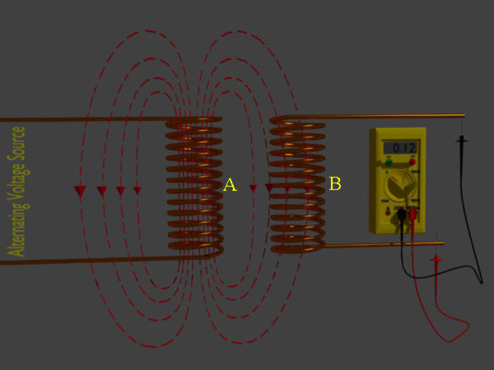
Mutual Inductance

Slide 31
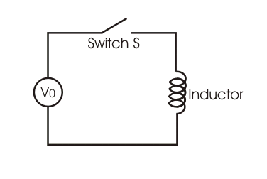
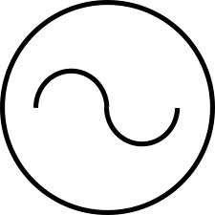
Advantages and Uses
Inductance used as storing device
Consider an inductor coil connected to a source through a switch.
When the switch is turned on voltage is applied across end of coil and
current through coil rises from 0 to maximum
At the same time emf is induced which is opposite
to the applied voltage(in terms of
Direction).
Now if the source is removed that
stored emf can be used to
provide current and current
decrease from maximum to 0.
Inductance Symbol

Slide 32
Relation between inductance and capacitance
As we studied that energy can be stored in the electric field between the plates of capacitor.
Similarly energy can be stored in the magnetic field of an inductor.

Slide 33
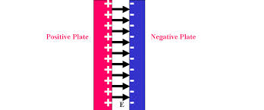
Energy stored in the electric field between the plates of capacitor.

Slide 34
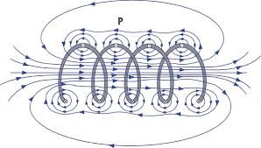
Energy stored in the magnetic field of an inductor.

Slide 35
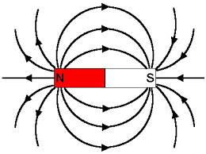
Creating North and south magnetic Poles
As we know that magnetic field start originates from north pole
and end on south pole. Similarly we can make magnetic poles
according to our choice with help of a solenoid or an inductor.
This is shown in the next slide.

Slide 36
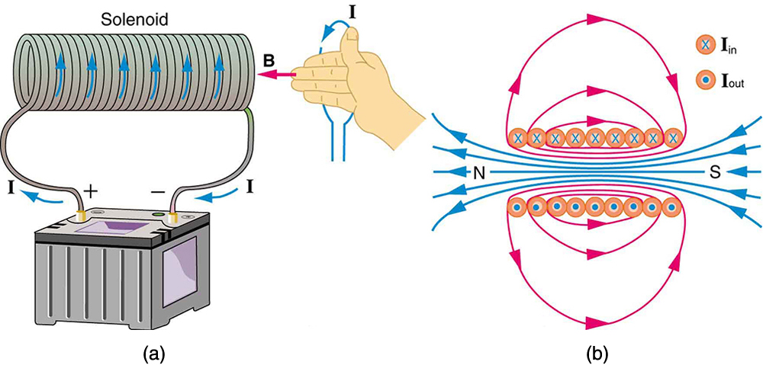
Direction of Current and Magnetic Field
North pole
South pole
Similarly if direction of current change, direction of (magnetic field)B
also changes and in result north and south poles
Change their places.

Slide 37
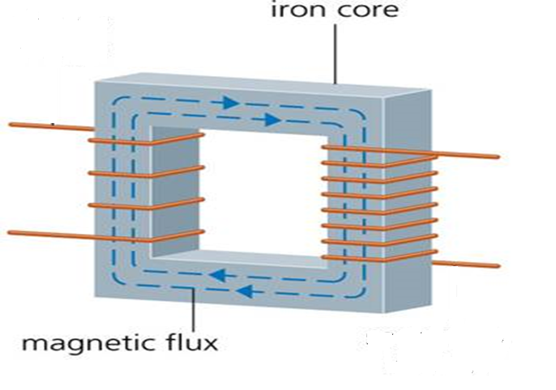
Mutual inductance phenomenon used in
Transformers

Slide 38
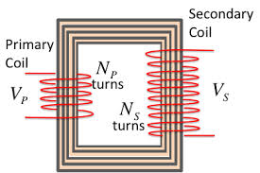
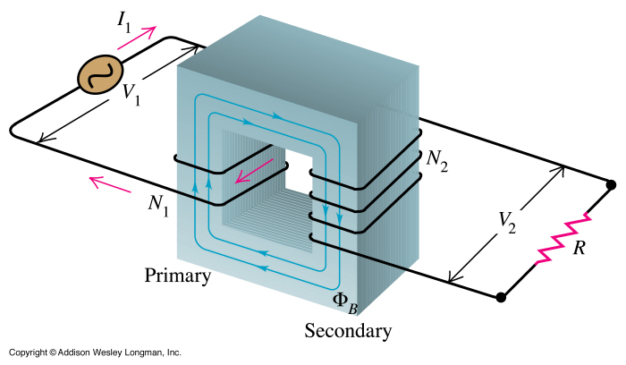
TRANSFORMERS

Slide 39

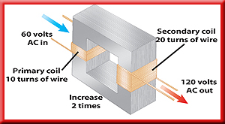
Similarly mutual inductance can create step up & step down transformers
Definition
A transformer that increases the voltage so that the output voltage is greater than the input voltage is a step-up transformer.
In a step-up transformer the number of wire turns on the secondary coil is greater than the number of turns on the primary coil.

Slide 40

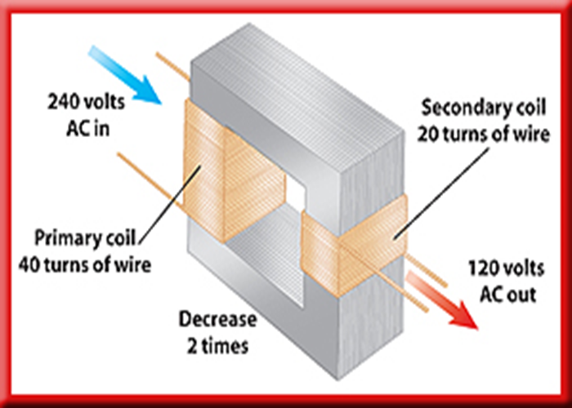
Definition :
A transformer that decreases the voltage so that the output voltage is less than the input voltage is a step-down transformer.
In a step-down transformer the number of wire turns on the secondary coil is less than the number of turns on the primary coil.

Slide 41
USES
Step up transformer use
used to increase voltage before transmitting electrical energy
over long distances through wires.
Step down transformer use
Transformers are also used in electronic products to step-down the voltage to a suitable level for the low voltage circuits in electronic products.
Mobile charger
Laptop charger
PC(Personal Computers) etc……….

Slide 42
REFERENCES
WIKIPEDIA
F.SC BOOK AND GUIDE
USING INTERNET
Some good physics sites
http://physicsworld.com/
http://scienceworld.wolfram.com/physics/
http://theory.uwinnipeg.ca/physics/

Slide 43


